Slide 1


CS 146: Data Structures and Algorithms July 16 Class Meeting
Department of Computer Science San Jose State University Summer 2015 Instructor: Ron Mak
www.cs.sjsu.edu/~mak

Slide 2
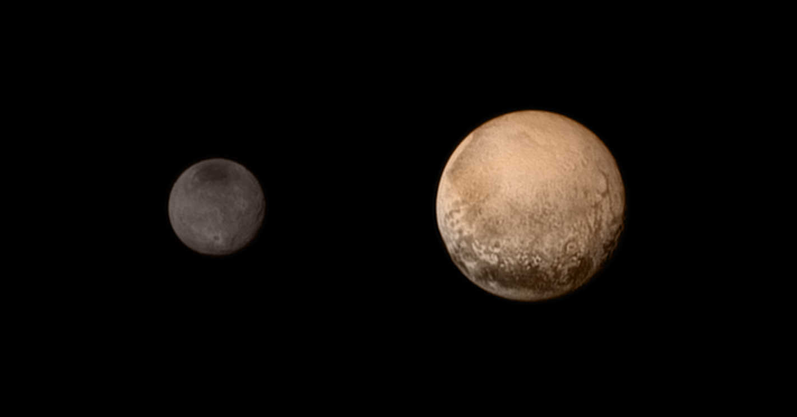
Pluto and Its Moon Charon

Slide 3
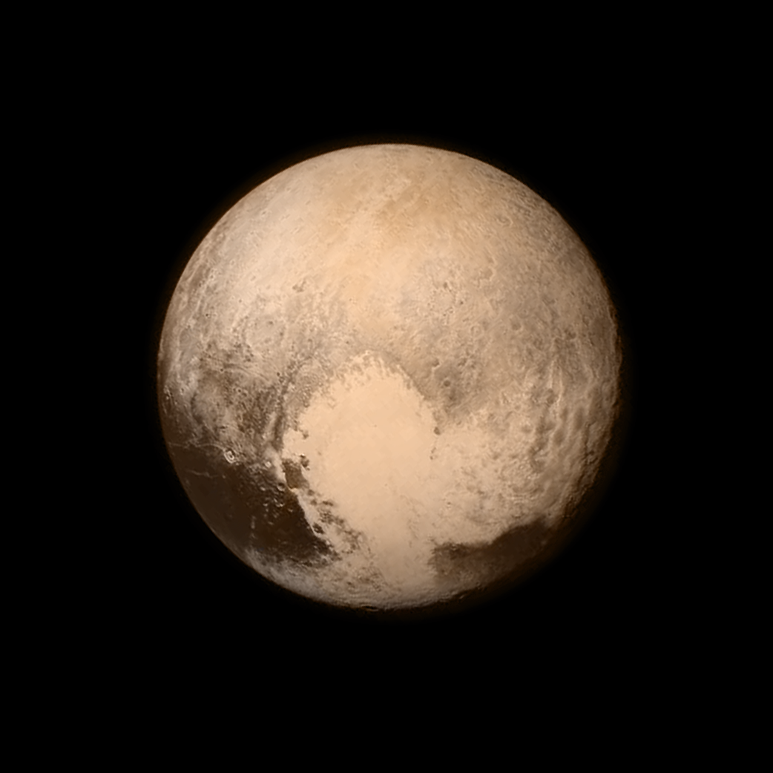
Pluto

Slide 4
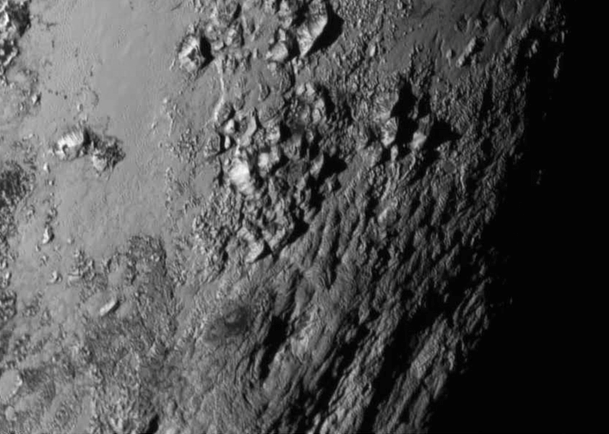
Pluto Closeup

Slide 5
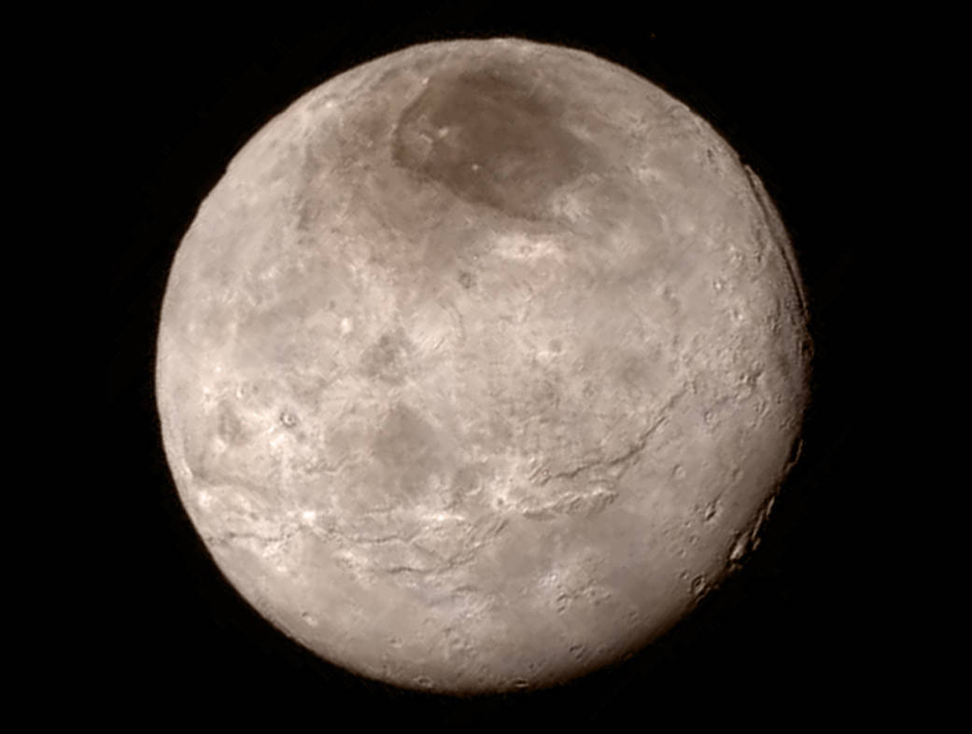
Pluto’s Moon Charon

Slide 6
The Disjoint Set Class
An ADT to solve the equivalence problem.
Used as an auxiliary data structure for other algorithms.
Define a relation R on members of a set S:
For each pair of elements (a, b), where a and b are in S, a R b is either true or false.
If a R b is true, then a is related to b.

Slide 7
Properties of an Equivalence Relation R
Reflexive: a R a for all a in S.
Symmetric: a R b if and only if b R a.
Transitive: If a R b and b R c then a R c.

Slide 8
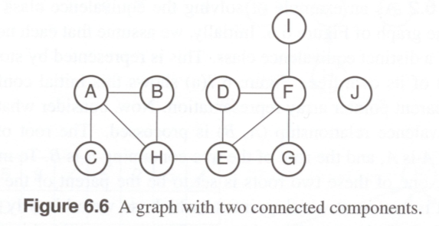
Example Disjoint Set Class
Nodes A through I are interconnected, but node J is disconnected from the others.
The nodes can represent cities and the edges can represent (two-way) roads between the cities.
Two cities are equivalent if there is a path between them.
Nodes A, H, and E are equivalent, but node J is not equivalent to any other node.
Data Structures and Algorithms in Java, 3rd ed.
by Mark Allen Weiss
Pearson Education, Inc., 2012
ISBN 0-13-257627-9

Slide 9
Dynamic Equivalence
Suppose we have an equivalence relation ~
Solve: For any a and b, is a~b?
The equivalence class of an element a in S is the subset of S containing all elements that are related to a.
If a~b is true, then a is related to b.
Every member of S belongs to exactly one equivalence class.
If a and b are in the same equivalence class, then a~b.

Slide 10
Dynamic Equivalence, cont’d
We start with a collection of N sets.
Each set has only one member.
Therefore, all relations except for reflexive are false.
Initially, all the sets are disjoint.

Slide 11
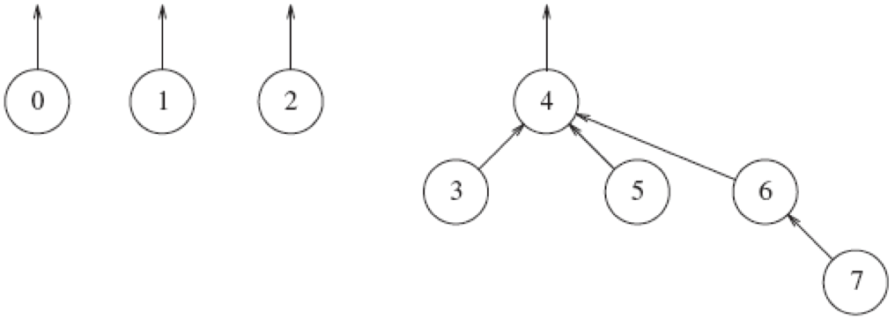
Disjoint Set as a Tree
Represent each disjoint set as a general tree.
A general tree can have more than two child nodes.
Name each tree by its root.
Only parent links are needed.
Four disjoint sets
Data Structures and Algorithms in Java, 3rd ed.
by Mark Allen Weiss
Pearson Education, Inc., 2012
ISBN 0-13-257627-9

Slide 12
Union/Find
Operation find
Given an element, return the name (root) of the equivalence set that contains the element.
Operation union
Test whether a and b are already related.
They are related if they’re in the same equivalence class.
If they are not related, add the relation a~b by performing a union of their equivalence classes.
The equivalence classes of a and b are destroyed.
The union class is disjoint from the remaining classes.

Slide 13
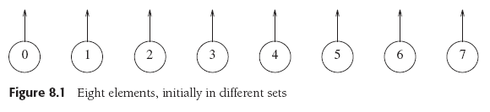
Union Examples
Data Structures and Algorithms in Java, 3rd ed.
by Mark Allen Weiss
Pearson Education, Inc., 2012
ISBN 0-13-257627-9

Slide 14
Disjoint Sets as Arrays
Represent the general tree nodes as an array.
Each entry a[i] of the array represents the parent of node i.
If node i is a root, then a[i] = -1.
Data Structures and Algorithms in Java, 3rd ed.
by Mark Allen Weiss
Pearson Education, Inc., 2012
ISBN 0-13-257627-9

Slide 15
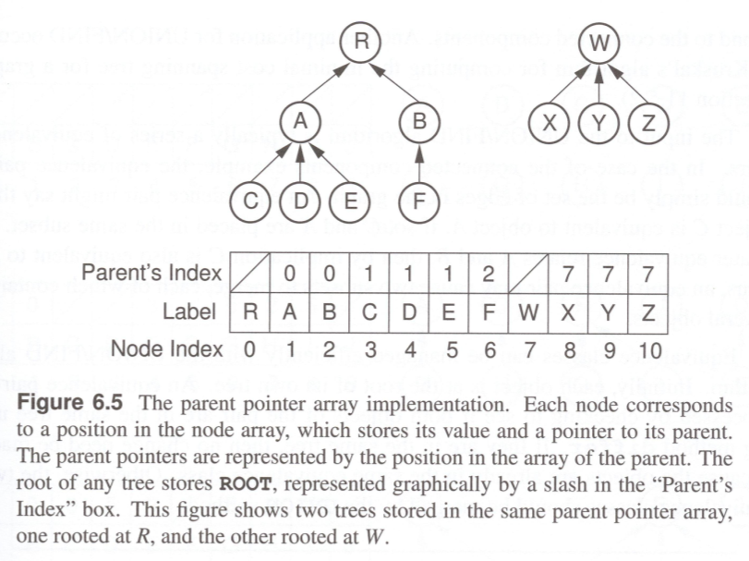
Disjoint Sets as Arrays, cont’d
Data Structures & Algorithm Analysis in Java
by Clifford A. Shaffer
Dover Publications, 2011
ISBN 978-0-486-48581-2

Slide 16
Methods
find(x)
Return the root of the tree that contains node x.
union(a, b)
Merge the two trees representing the sets by making the parent link of one tree’s root link to the root node of the other tree.

Slide 17
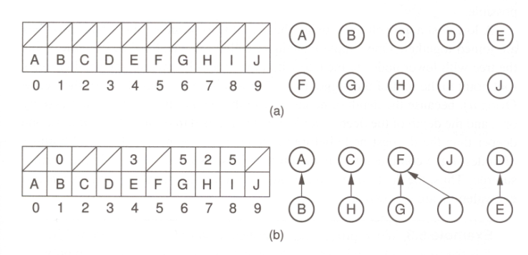
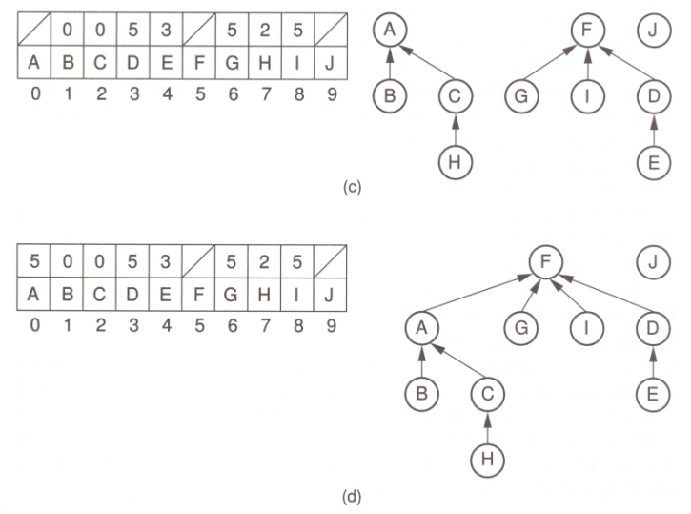
Union Operation
Initial configuration: Each node is in its separate equivalence class.
The result of processing the equivalence relations (A,B), (C,H), (G,F), (D,E), and (I,F)
Processing equivalence relations (H,A) and (E,G).
Processing equivalence relation (H, E)
Data Structures & Algorithm Analysis in Java
by Clifford A. Shaffer
Dover Publications, 2011
ISBN 978-0-486-48581-2

Slide 18
Smart Union Algorithm: Union-by-Size
Union-by-size
AKA weighted union rule
Join the tree with the fewer nodes to the tree with more nodes.
Make the smaller tree’s root point to the larger tree’s root.
Keep track of the size of each tree.
In the array element for the root node, record the negative of the size of the tree.
After a union, the new size is the sum of the old sizes.

Slide 19
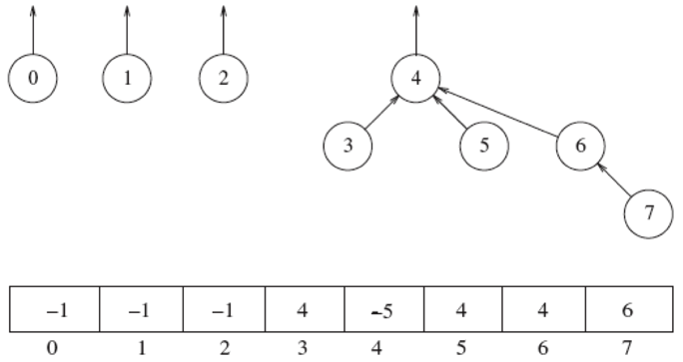
Smart Union Algorithm: Union-by-Size, cont’d
Arbitrary union:
Union-by-size:
Data Structures and Algorithms in Java, 3rd ed.
by Mark Allen Weiss
Pearson Education, Inc., 2012
ISBN 0-13-257627-9

Slide 20
Smart Union Algorithm: Union-by-Size, cont’d
Limit the total depth of the tree to O(log N).
The depth of the nodes in the in the smaller tree each increases by 1.
The depth of the deepest node in the combined tree increases by at most 1 deeper than the deepest node before the trees were combined.
The number of nodes in the combined tree is at least twice the number of nodes in the smaller tree.
Therefore, the depth of any node can increase at most log N times after N equivalences are processed.

Slide 21


Smart Union Algorithm: Union-by-Height
Union-by-height
Make the shallower tree a subtree of the deeper tree.
Keep track of the height of each tree in the array.
Data Structures and Algorithms in Java, 3rd ed.
by Mark Allen Weiss
Pearson Education, Inc., 2012
ISBN 0-13-257627-9

Slide 22
Disjoint Set Class
public class DisjointSet
{
public DisjointSet(int numElements)
{
s = new int[numElements];
for (int i = 0; i < s.length; i++) {
s[i] = -1;
}
}
public int find(int x)
{
if (s[x] < 0) {
return x;
}
else {
return find(s[x]);
}
}
...
}

Slide 23
Disjoint Set Class
public class DisjointSet
{
...
public void union(int root1, int root2)
{
// root2 is deeper.
if (s[root2] < s[root1]) {
s[root1] = root2; // make root2 the new root
}
// root 1 is the same or deeper.
else {
if (s[root1] == s[root2]) {
s[root1]--; // update height if same
}
s[root2] = root1; // make root1 the new root
}
}
...
}

Slide 24
Path Compression
A side effect of the find(x) operation.
Change the parent of each node from x to the root.
Make each parent point directly to the root.
Keep the cost of find operations low.

Slide 25
Path Compression, cont’d
public int find(int x)
{
if (s[x] < 0) {
return x;
}
else {
return s[x] = find(s[x]);
}
}

Slide 26
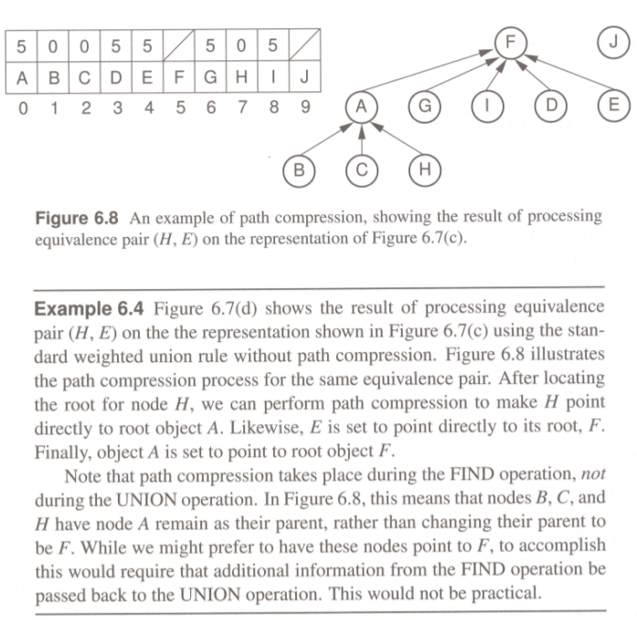
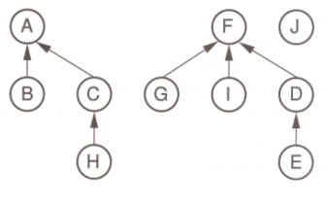
Path Compression
Figure 6.7(c)
Data Structures & Algorithm Analysis in Java
by Clifford A. Shaffer
Dover Publications, 2011
ISBN 978-0-486-48581-2

Slide 27
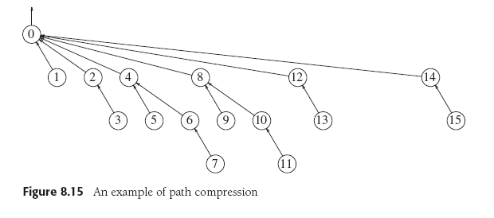
Path Compression
find(14)
Data Structures and Algorithms in Java, 3rd ed.
by Mark Allen Weiss
Pearson Education, Inc., 2012
ISBN 0-13-257627-9

Slide 28
An Application: Maze Generation
Data Structures and Algorithms in Java, 3rd ed.
by Mark Allen Weiss
Pearson Education, Inc., 2012
ISBN 0-13-257627-9

Slide 29
An Application: Maze Generation
Randomly target two adjacent cells
that are separated by a wall.
If the cells are not already connected (they
are not in the same equivalence set), knock
down the wall by performing a union operation.
Repeat until the starting and ending cells are connected (they are in the same equivalence set).
For a better maze with more false leads:
Repeat until all the cells are connected.
Data Structures and Algorithms in Java, 3rd ed.
by Mark Allen Weiss
Pearson Education, Inc., 2012
ISBN 0-13-257627-9

Slide 30
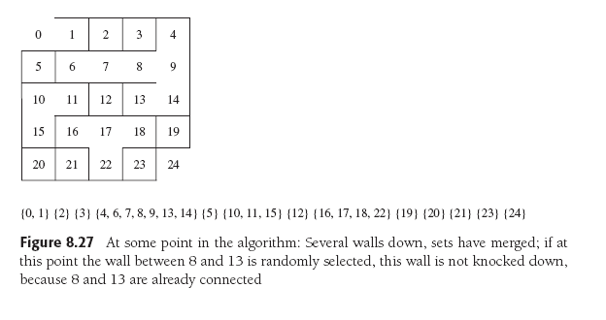
An Application: Maze Generation
Do not knock down the wall
between cells 8 and 13
because they’re already connected.
(8 and 13 are in the same equivalence set.)
Data Structures and Algorithms in Java, 3rd ed.
by Mark Allen Weiss
Pearson Education, Inc., 2012
ISBN 0-13-257627-9

Slide 31
An Application: Maze Generation
Knock down the wall between cells 13 and 18
because they’re not connected (13 and 18 are
in different equivalence sets) by performing a
union operation.
Data Structures and Algorithms in Java, 3rd ed.
by Mark Allen Weiss
Pearson Education, Inc., 2012
ISBN 0-13-257627-9

Slide 32
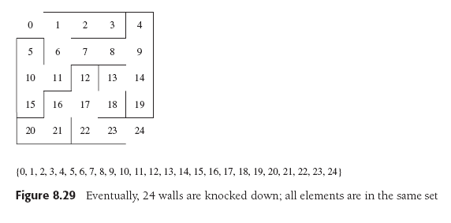
An Application: Maze Generation
The maze is done.
All the cells are in the
same equivalence set.
Data Structures and Algorithms in Java, 3rd ed.
by Mark Allen Weiss
Pearson Education, Inc., 2012
ISBN 0-13-257627-9

Slide 33
Maze Generation Tutorial
http://forum.codecall.net/topic/63862-maze-tutorial/
Demo

Slide 34
Break

Slide 35
Graphs
A graph is one of the most versatile data structures in computer science.

Slide 36
Uses of Graphs
Model connectivity in computer and communications networks.
Represent a map of locations and distances between them.
Model flow capacities in transportation networks.
Find a path from a starting condition to a goal condition.
Model state transitions in computer algorithms.
Model an order for finishing subtasks in a complex activity.
Model relationships such as family trees, business and military organizations, and scientific taxonomies.

Slide 37
Graph Terms
A graph G = (V, E) is a set of vertices V and a set of edges (arcs) E.

Slide 38
Graph Terms, cont’d
An edge is a pair (v, w), where v and w are in V.
If the pair is ordered, the graph is directed and is called a digraph.
Vertex w is adjacent to vertex v if and only if (v, w) is in E.
In an undirected graph, both (v, w) and (w, v) are in E.
v is adjacent to w, and w is adjacent to v.
An edge can have a weight or cost component.

Slide 39
Graph Terms, cont’d
A path is a sequence of vertices w₁, w₂, w₃, ..., w_{N} where (w_{i}, w_{i+1}) is in E, for 1 ≤ i < N.
The length of the path is the number of edges on the path.
A simple path has all distinct vertices, except that the first and last can be the same.

Slide 40
Graph Terms, cont’d
A cycle in a directed graph is a path of length ≥ 1 where w₁ = w_{N}.
A directed graph with no cycles is acyclic.
A DAG is a directed acyclic graph.
Data Structures and Algorithms in Java, 3rd ed.
by Mark Allen Weiss
Pearson Education, Inc., 2012
ISBN 0-13-257627-9

Slide 41
Graph Terms, cont’d
An undirected graph is connected if there is a path from every vertex to every other vertex.
A directed graph with this property is strongly connected.
A directed graph is weakly connected if it is not strongly connected but the underlying undirected graph is connected.

Slide 42
Graph Terms, cont’d
A complete graph has an edge between every pair of vertices.
The indegree of a vertex v is the number of incoming edges (u, v).

Slide 43
Graph Representation
Represent a directed graph with an adjacency list.
For each vertex, keep a list of all adjacent vertices.
Data Structures and Algorithms in Java, 3rd ed.
by Mark Allen Weiss
Pearson Education, Inc., 2012
ISBN 0-13-257627-9

Slide 44
Topological Sort
We can use a graph to represent the prerequisites in a course of study.
A directed edge from Course A to Course B means that Course A is a prerequisite for Course B.
Data Structures and Algorithms in Java, 3rd ed.
by Mark Allen Weiss
Pearson Education, Inc., 2012
ISBN 0-13-257627-9

Slide 45
Topological Sort, cont’d
A topological sort of a directed graph is an ordering of the vertices such that if there is a path from v_{i} to v_{j}, then v_{i} comes before v_{j} in the ordering.
The order is not necessarily unique.
Data Structures and Algorithms in Java, 3rd ed.
by Mark Allen Weiss
Pearson Education, Inc., 2012
ISBN 0-13-257627-9

